Slide 1
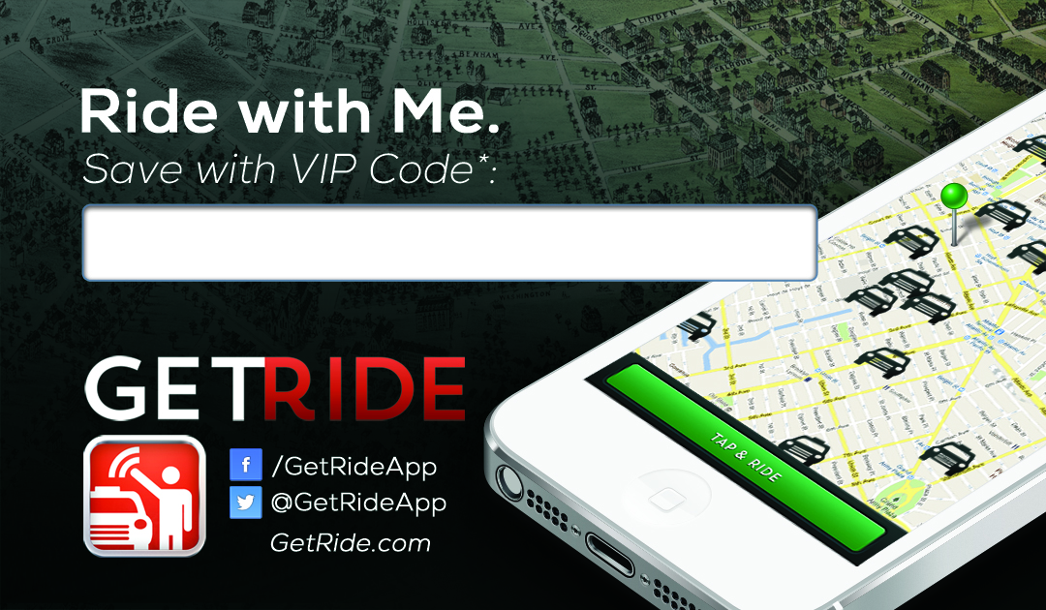
Type your Cell # Here
Type your Cell # Here
Book me
GetRide Passenger Android / iPhone App
Use VIP Code to Save $5 Off 1st Ride
Book me
GetRide Passenger Android / iPhone App
Use VIP Code to Save $5 Off 1st Ride
Type your Cell # Here
Type your Cell # Here
Book me
GetRide Passenger Android / iPhone App
Use VIP Code to Save $5 Off 1st Ride
Book me
GetRide Passenger Android / iPhone App
Use VIP Code to Save $5 Off 1st Ride

